Slide 1

RETAILCORE:
Hyperlocal Micro-ERP System
Inventory & Billing Engine for the Unorganized Retail Sector

Slide 2
The Challenge: Despite their importance, 90% of these shops still rely on manual methods like pen, paper, and memory.
The Scope: India has over 12 million "Kirana" (local) stores, which form the backbone of our daily economy.
The Gap: Most modern billing software is too expensive (Rs. 10k+) or requires high-end computers that local shopkeepers do not possess.
Our Mission: To build a "Zero-Cost," high-performance digital tool tailored specifically for the local Indian market.

Slide 3




Why Do Local Shops Struggle?
Inventory Shrinkage: Shopkeepers losesignificant profit because they cannot track expiring items or lost stock manually.
The "Loose Item" Complexity: They fail to handle "loose" items like 500g of Sugar, 250g of Dal, or 100ml of Oil.
Lack of Data: Without data, a shopkeeper doesn't know their "Best Selling Item" or their "Dead Stock."

Slide 4

Introducing RetailCore
RetailCore is a specialized "Micro-ERP (Enterprise. Resource Planning) system built entirely in C.
Lightweight: Runs seamlessly on legacy hardware (Pentium 4, Old Laptops)
Fast: Uses low-level memory management for instant billing.
Offline-First: Does not require an active internet connection to function.
Goal: To replace the physical "Khata" book with a robust, error-free digital ledger.

Slide 5

How It Works: The System Architecture
The Brain (Logic Layer): Written in C for maximum execution speed.
The Memory (Storage Layer): Uses a CSV (Comma Separated Values) File Database.
Ensures data is portable the shopkeeper can open their database in Microsoft Excel analyse→
The Safety Mechanism: Implements "Atomic Saves"-data is written to the hard drive immediately after every transaction to prevent loss during power cuts.

Slide 6
Feature Spotlight: Hybrid Inventory Logic
Unlike standard billing apps that only count Integers (1, 2, 3 packets), RetailCore uses a Float-Based Logic.
Allows the billing of fractional quantities specifically for the Indian market.
Example: A customer buys 0.250 Kg of Turdal and 1 Packet of Biscuits. The system accurately deducts 0.250 from the main stock of 50.00 Kg, leaving exactly 49.75 Kg remaining.
This eliminates "weight-loss" errors in the shop's daily audit

Slide 7
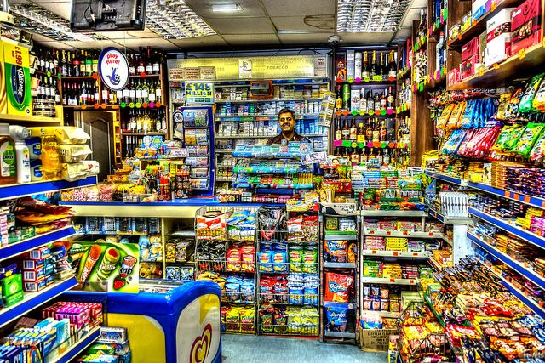
The "Dukan Alert" System :
The systern doesn't just record sales; it actively monitors the health of the inventory.
The Logic: We implemented a Threshole Algorithm.
If (Cument Stock<Minimum Limit) Trigger Alert()
The Result:
Before opening the shop, the owner runs the "Low Stock Audit
The system instantly generates a 'Shopping List of items that are about to run out, preventing lost sales for the clay.

Slide 8
Handling Scale: 2,500+ Items
Stress Testing: We didn't just test with 10 items. We successfully loaded a database of 2,500 unique products.
Search Efficiency: Using efficient linear traversal andmemory indexing, the system retrieves any item ID in less than 0.01 seconds.
Transaction Speed: The time taken from "Scanning anItem" to "Updating the Database" is instantaneous, ensuring no long queues at the counter.
Title Here
Title Here

Slide 9
Handling Scale: 2,500+ Items
Summary: Retail Core is not just a college project; it is avaiable, scalable, and necessary tool for the unorganized retail sector.It combines the Power of C with the Practical Needs of a local business.
Future Roadmap:
Adding a Graphical User Interface (GUI).
Integration with WhatsApp API to send digital bills directly to customers.
Title Here
Title Here

Slide 10
Thank You !!

